Slide 1

01
EP Proposal | June 2020
A.L.I.C.E
Cornelius Yap, Samuel Lye, Tiffany Goh

Slide 2

02
Presentation Highlights
Overview of Alice
Components
Classification
Topic Modelling
Text Summarisation
Sentiment Analysis
NER (Named Entity Recognizer)
Relation Extraction
Front End
Back End
3. User Experience
EP Proposal | June 2020

Slide 3

03
EP Proposal| JUNE 2020
A.L.I.C.E
Objective
Analyzing Language Interface Created for Everyone (A.L.I.C.E.) summarizes text documents and displays a graphical representation of them that enables ease of understanding complex relationships within text and drawing of insights from visualisations.

Slide 4





04
Overview of Design
Sends document via HTTP Post
Runs Natural Language Processing (NLP) models
Outputs in json format
D3
Sends outputs as response message
EP Proposal| JUNE 2020
Notes:
This slide shows the overview of design for Alice. We have React as the frontend and we use D3 for the visualisation of our results. The backend is run by flask where it consolidates all the output of the various code for the different features of Alice. The features of Alice also includes the usage of libraries such as keras Spacy and Tensorflow

Slide 5
05
Overview of Design
Classification
2) Topic Modelling
3) Text Summarisation
Runs Natural Language Processing (NLP) models
4) Sentiment Analysis
5) Named Entity
Recognition
6) Relation Extraction
EP Proposal| JUNE 2020
Notes:
This slide shows the overview of design for Alice. We have React as the frontend and we use D3 for the visualisation of our results. The backend is run by flask where it consolidates all the output of the various code for the different features of Alice. The features of Alice also includes the usage of libraries such as keras Spacy and Tensorflow

Slide 6
06
Classification
Classifies document into either of the 6 categories: Crime, Tech, Health, Finance, Terrorism, Politics
Completed
Challenges
Enhancements
Attempted machine learning models
Logistic Regression (0.84)
LinearSVC (0.82)
Naive Baye (0.88)
Attempted deep learning models
Word Embedding + Bidirectional LSTM (0.75)
XLNET (0.78)
Deep learning models have a lower accuracy due to:
Inadequate training data
Requires longer training hours
More computing resources
Further improve deep learning models
Clustering of documents with past documents
Sub classification
Covid-19 government initiative
Covid-19 world news
Notes:
For text classification, we have attempted machine learning models and deep learning models. Amongst these models, Naive Baye has the highest accuracy of 0.88. Naive Baye model is a probabilistic machine learning model commonly used for text classification. Features extracted from the text includes tf-idf vectors, followed by filtering of vocabularies with extreme tf-idf values. Moving on to deep learning, XLNET is the state of the art text classification model. It uses a hybrid of autoregression language modelling and autoencoding, along with attention layers to achieve the high accuracy results.
Unfortunately, upon training, we realise it has a lower accuracy as compared to other training models. The main reason is due to the lack of training data. Available datasets such as AG news are collected around 2002, which leads to different features extracted from the text, thus low accuracy.
For enhancements, we plan to
further improve the accuracy of the deep learning models
cluster documents with past documents
further classify for instance the health/COVID-19 documents into COVID- 19 government initiatives or COVID-19 world news

Slide 7
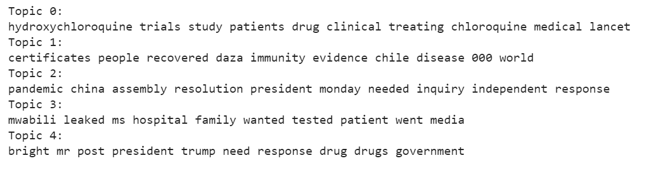
07
Topic Modelling
Find group of words (i.e. topic) that best represents the content of the document
Completed
Challenges
Enhancements
Latent Dirichlet Allocation (LDA)
Non-Negative Matrix Factorisation (NMF)
Word Embedding + Principal Component Analysis (PCA) + TF-IDF
Topics requires inference from list of words
Use word2vec to infer topics from the bag of words
E.g King + Man - Women = Queen
Notes:
We have attempted three models, namely Latent Dirichlet Allocation, Non-negative Matrix Factorisation and Principal Component Analysis. The first two decomposing document term matrix into document-topic matrix and topic-term matrix. For the last model,the word embedding captures the meaning of the documents. PCA then clusters documents with similar meaning to form a topic. TF-IDF is subsequently used to uncover the topic by finding words that describe the topic.
Referring to the image, the topics are not explicitly stated and requires us to infer. This is subjective and result in misinterpretation at times. Hence, moving forward, we plan to use word2vec to infer the topic from the bag of words outputted from the NMF model. For instance, queen can be inferred from the bag of words king, man and women

Slide 8
Text Summarisation
08
Provide a short summary of the given text
Completed
Challenges
Enhancements
Used TextRank Algorithm to provide extractive summary
Currently implemented method
Attempted deep learning for abstractive summary
Sequence to Sequence Architecture
LSTM Attention models
Hard to find suitable dataset to train the deep learning model
Hard to find suitable metrics to test the model
Complicated deep learning structure
Long training times due to more complex algorithm compared to conventional models
Research more into using deep learning for abstractive summary
Learn more about the different models
Continue to work on and attempt to improve the current model
Try with different word embeddings such as word2vec or GloVe
Try out different models such as bidirectional LSTM
Notes:
Attempted two different methods for Text summarization. The first methods involves using TextRank algorithm to provide an extractive summary of the text. This means that the summary is made up of the important sentences in the text
For abstractive summary, we attempted using a sequence to sequence deep learning model with LSTM and Attention. However, this is one of the challenge for us as there is very little suitable dataset to train our model. The sequence to sequecne model also have a more complicated structure which involves longer training times. Furthermore, it is hard to find a suitable metrics to test the accuracy of our model
For the enhancements, we plan to research more into the various deep learning methods for abstractive summary and continue to work on it and improve by trying different word embeddings such as word2vec or GloVe as well as to try out different models such as bidirectional lstm

Slide 9
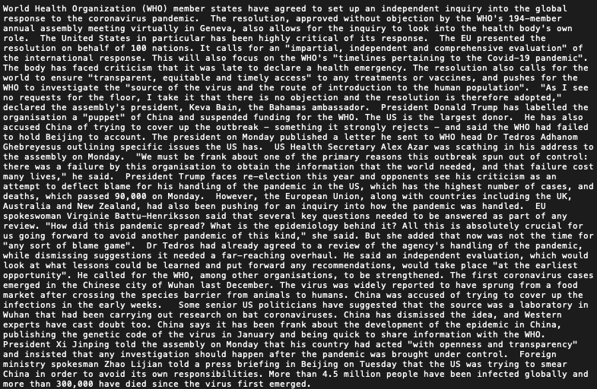
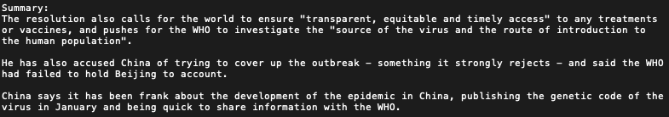
SUMMARIZED

Slide 10
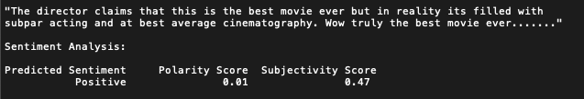
Sentiment Analysis
09
Determine if the text is positive or negative as well as the extent of subjectivity of the text
Completed
Challenges
Enhancements
Attempted Lexicon-based method
Vader, Pattern, Sysnset
Currently implemented method
Attempted Machine Learning
Linear SVC (90% acc)
Attempted Deep Learning
LSTM (88% acc)
Lack of contextual data for machine learning methods
Currently trained off IMDB movie review
Hard to detect sarcasm
E.g. “wow best movie ever…”
Sentiment is mostly a subjective issue
With operation related data specific to the domain, the performance of the model should improve
Notes:
For sentiment analysis, we attempted using lexicon based method, machine learning and deep learning. For the current implementation of Alice, we are using the lexicon based methods despite the high accuracy of the machine learning models. This is because the machine and deep learning models are trained off IMDB movie reviews and is not as accurate in analysing the sentiments of news articles. Other challenges we face include sentiment being a subjective issue and it is also hard to detect sarcasm. For example, the phrase “wow best movie ever” can either mean positive or negative depending on the context.
For enhancements, given the high accuracy of the machine learning models, if we are given more contextual data for training, the models can possibly outperform the current lexicon based method

Slide 11
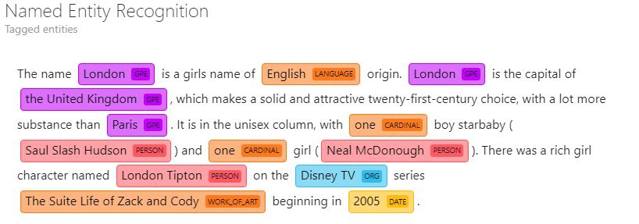
10
Named Entity Recognition
Identify key words or phrases that clearly identifies one item from a set of other items that have similar attributes
Completed
Challenges
Enhancements
Attempted deep-learning and feature-based supervised learning models
NLTK (Stanford Named Entity tagger)
Spacy (Bloom embeddings and residual CNN)
Flair (Transformer-based BiLSTM)
One of the major challenges in identifying named entities is recognizing words which can have multiple meanings in different sentences
Train NER models using more domain-specific training data to improve accuracy in the operational context
Notes:
We looked at 3 streams of NER during these 3 weeks:
1.Unsupervised learning approaches, which rely on unsupervised algorithms without hand-labeled training examples (NLTK, Stanford Named Entity tagger)
2.Feature-based supervised learning approaches, which rely on supervised learning algorithms with careful feature engineering (Spacy)
3.Deep-learning based approaches, which automatically discover representations needed for the classification from raw input (Flair)
Flair is currently the SOTA approach in NER. We decided to use Flair, which is a new framework for sequence labelling (NER and parts of speech tagging). By learning to predict the next character on the basis of previous characters, Flair is able to leverage the internal states of a trained character language model to produce a novel type of word embedding which its developers refer to as contextual string embeddings. These embeddings have the distinct properties that they (a) are trained without any explicit notion of words and thus fundamentally model words as sequences of characters, and (b) are contextualized by their surrounding text, meaning that the same word will have different embeddings depending on its contextual use. Flair achieved one of the higher performance (89.3%) on OntoNotes5.0 and the state-of the-art performance (93.18%) on CoNLL03.

Slide 12
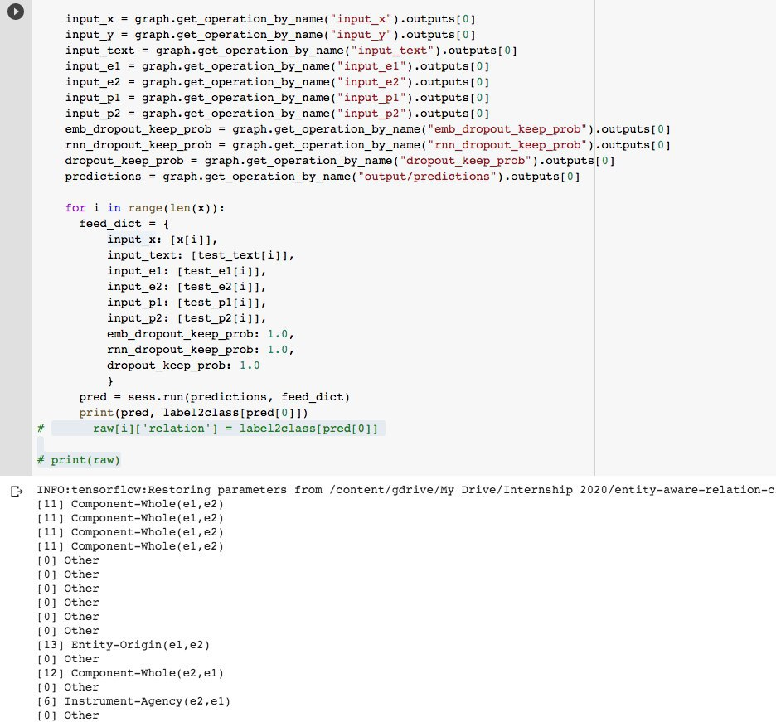
Relation Extraction
11
Extracting semantic relationship from text, between two or more entities
Completed
Challenges
Enhancements
Attempted Attention-based models
BiLSTM Attention and BiLSTM Networks with Entity-aware Attention using Latent Entity Typing
Created end-to-end NER and relation model
No existing pre-trained relation extraction model
Transformer models require higher computational power and time to train
Explore state-of-the-art relation extraction technology, namely Bidirectional Encoder Representations from Transformers (BERT)
Notes:
Initially, since there are no current python libraries out there for relation extraction, we decided to create our own custom algorithm for this feature. The basic model we explored was using an unsupervised approach where relations could be detected between two entities based on the contextual clues given in a single sentence. However, this approach was rather rigid and we decided to explore the use of SOTA approaches.
We evaluated both a BiLSTM attention model and a BiLSTM Networks with Entity-aware Attention using Latent Entity Typing. We discovered that the latter worked better, achieving a F1-Score of 85.2 (SOTA = 89.5).
In the MP stage, we hope to train a transformer-based model, namely BERT. Difference between SOTA models (BERT and ELMo): BERT uses a bidirectional Transformer while ELMo uses the concatenation of independently trained left-to-right and right-to-left LSTM to generate features for downstream task. In other words, BERT is deeply bidirectional, as opposed to ELMo (shallow bidirectional) à https://towardsdatascience.com/from-pre-trained-word-embeddings-to-pre-trained-language-models-focus-on-bert-343815627598 this article is useful to understand

Slide 13
12
Back End – Web Server
Completed
Challenges
Enhancements
Integrated all the codes for the different ALICE features together
Set up Flask as our backend server
Integrating the different codes together was a challenge as everyone was working on different environments
Old and new Python versions
Different versions of modules used
Tf1 vs Tf2
To solve the issue of trying to run everyone’s code on the same environment, we plan to use containers
Dockers and Kubernetes
Notes:
For backend, we have done a very basic web server using flask. The backend also includes the compilation of our all codes used for the different features of Alice. However, integrating the different codes was a challenge as everyone was working on different environments and we had to find a common environment that all the codes can run off. For example, we trained our models on tensorflow1 which was not compatible with python version 3.8 that the backend was running. However, tensorflow 2 is only supported by python 3.7 and above and was also not compatible with tensor flow 1
To solve such issues, we plan to implement containers for our code and we will be using Dockers and Kubernetes to help us do so.

Slide 14
13
Front End - Dashboard
Completed
Challenges
Enhancements
Topic modelling bubble
Sentiment graph
Editable relation extraction table
Editable named entity table
NER Displacy
Network graph (relation extraction and named entities) – Allows for filtering
Fullscreen mode for network graph
Visualization must be able to “tell a story” and not be isolated components
Provide customizability for visualization
UI colors
Draggable components
Frequency of links should be displayed in the network graph
Enhance upload screen and error page
Notes:
For the frontend, we created the basic visualization tools for our various ML models. In the user interface, we will demonstrate how the output will be like.
For enhancements for the MP stage, we plan to enhance the UI by:
1.Making the fonts and colors more visually aesthetic
2.Provide customizability for visualization (users can specify certain filters for the visualization output)
3.Draggable components which allow for customizability of dashboard layout
4.Frequency of links should be displayed in the network graph
5.Create a proper upload, settings, and error page
6.Allow for saving of template to database

Slide 15
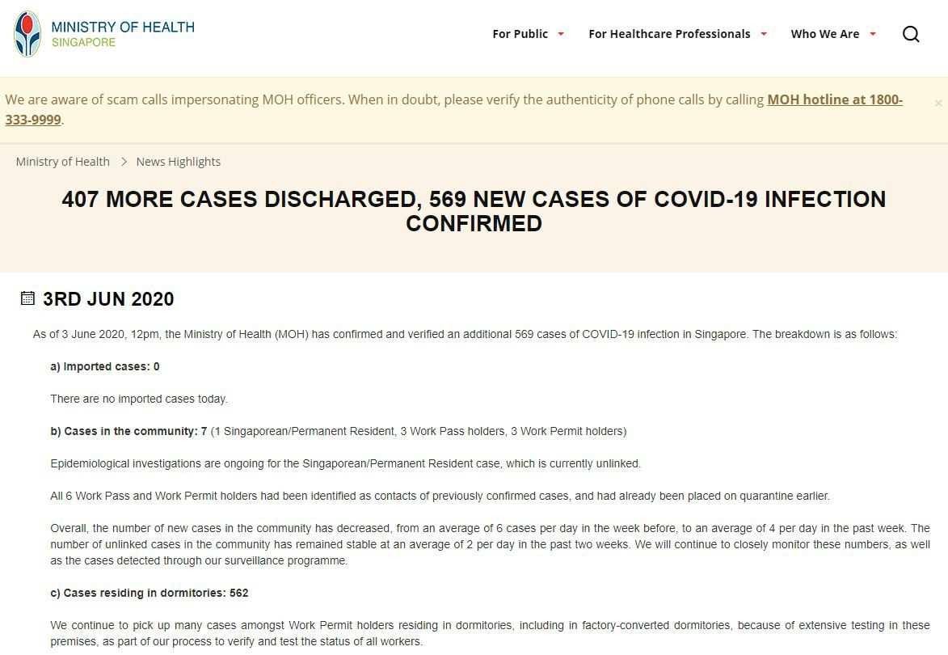
14
Test Corpus
EP Proposal| JUNE 2020
Notes:
Now, we will walk through a use case of ALICE by imagining ourselves as a data analyst for a government agency. We would like to analyze a piece of news that was flagged by our news scraper, so we now input it into ALICE.

Slide 16

Test Corpus
Notes:
Now, we will walk through a use case of ALICE by imagining ourselves as a data analyst for a government agency. We would like to analyze a piece of news that was flagged by our news scraper, so we now input it into ALICE.

Slide 17
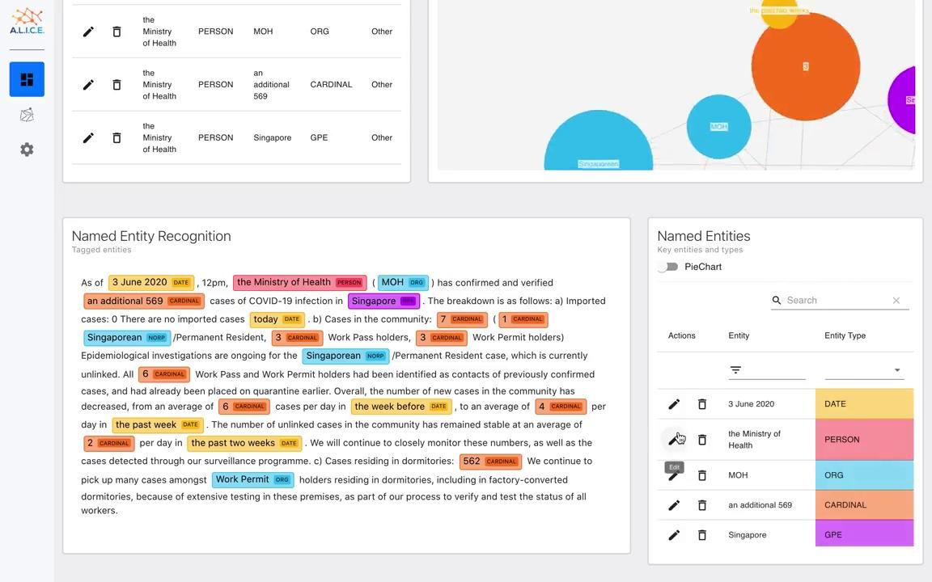
Notes:
Now, we will walk through a use case of ALICE by imagining ourselves as a data analyst for a government agency. We would like to analyze a piece of news that was flagged by our news scraper, so we now input it into ALICE.

Slide 18
Notes:
Now, we will walk through a use case of ALICE by imagining ourselves as a data analyst for a government agency. We would like to analyze a piece of news that was flagged by our news scraper, so we now input it into ALICE.

Slide 19
18
Conclusion
What have we done so far?
Study and research into the natural language processing (NLP) and visualization tools
Conduct Proof of Concepts (POC) testing by crating an informative text summarizer
Develop greater understanding and knowledge of fundamental machine learning concepts and NLP tools to create a functioning end product
What have we learnt so far?
Hardskills
Keras/Tensorflow
Nltk/Sklearn/Gensim
Good coding practices
Agile Methodology
Future work for MP
Continuous training and improvement of deep learning models
Implement ALICE using dockers
For MP, best of breed will be adopted
Users can try different models to obtain a wider perspective of the data
Notes:
In conclusion, we have achieved some of the objectives of our project as highlighted in our EP slides and we will continue to work towards the rest of them and improve ourselves and our product.
During these 4 weeks, we have attained both hard and soft skills, in terms of being a good software developer and a team player.
For the MP, we will improve the work on ALICE through her various components to achieve a functioning end product by the end of this internship :)

Slide 20
19
EP Proposal | June 2020
Thank you!

